Slide 1

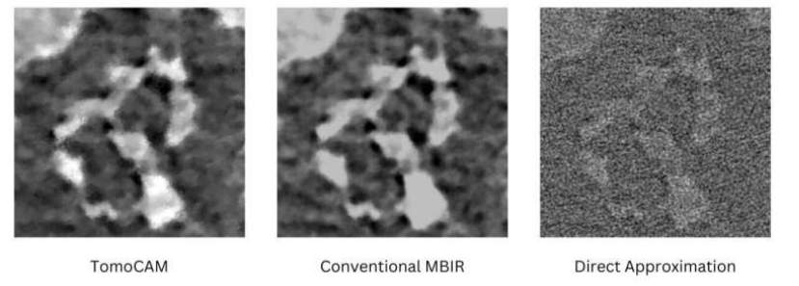
Review of Tomocam
Reconstruction via gpu ACCELERATION and nufft
Ee21b056 k Pranav Reddy
EE21B040 Poornachandra Giridhar

Slide 2
Tomography
Tomography is a technique for imaging the internal structures of objects without physically dissecting them. It involves capturing a series of 2D images (slices) from different angles around the object and using these slices to reconstruct a 3D representation of the internal structure.
Its importance lies in its ability to provide detailed cross-sectional images of the body, allowing healthcare professionals to visualize internal structures and identify various medical conditions. It is the most frequently used imaging modality for diagnosis due to its wide availability, short ac- question time, and ability to distinguish bones and various tissues within the body efficiently

Slide 3
LIMITATIONS OF EXISTING METHODS
In dynamic or challenging experimental conditions, methods like filtered back projection (FBP) are commonly used for their simplicity and computational efficiency, they may indeed result in lower-quality reconstructions in situations where samples are evolving, susceptible to radiation damage, or when experimental geometry poses limitations. In such cases, more advanced and iterative reconstruction methods become essential for improving the quality and accuracy of the reconstructed images.
Direct approximation methods like FBP rely on a sufficient number of projections from various angles to reconstruct a high-quality image. In situations where the experimental geometry restricts the acquisition of sufficient views.
In cases where only a limited range of projection angles is available (limited-angle tomography), direct methods may struggle to produce accurate reconstructions
In summary, while direct approximation methods like FBP are valuable for their simplicity and speed, their limitations become apparent in complex experimental scenarios.

Slide 4
Limitations of existing methods
Model-Based Iterative Reconstruction (MBIR): In medical imaging, particularly in computed tomography (CT) scans, MBIR refers to a reconstruction technique. It involves using mathematical models and iterative algorithms to reconstruct high-quality images from raw data obtained during imaging.
However, current CPU-based implementations of MBIR typically require a large compute cluster to achieve turnaround times that are comparable with data collection times. This not only adds extra time to the experiment-to-analysis loop but also places an additional burden on material scientists, who must acquire a new set of expertise in using a compute cluster.

Slide 5
tomocam
TomoCAM is GPU accelerated implementation of MBIR that is based on the nonuniform fast Fourier transforms (NUFFT) approach .
TomoCAM overcomes these computational cost limitations by reformulating the fundamental operators in MBIR in terms of the sample's Fourier coefficients, which describe the fundamental frequencies of the sample's density, similar to the individual notes that make up a piece of music.
GPU (Graphics Processing Unit) based acceleration involves using the computational power of GPUs to perform specific tasks, in addition to their traditional role in rendering graphics. GPUs are highly parallel processors with many cores designed for handling large amounts of data simultaneously. This parallel processing capability makes GPUs well-suited for certain types of computations beyond graphics rendering, leading to significant acceleration in various applications

Slide 6

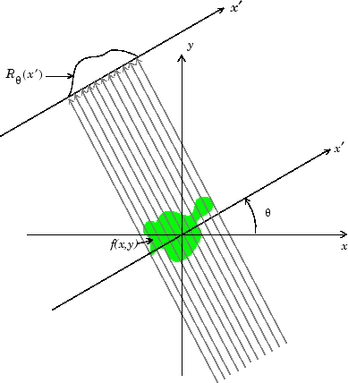
Radon transform
The Radon Transform is the integral transform that takes a function f(x,y) defined on the plane to a function Rf defined on the space of lines in the plane, whose value at a particular line is equal to the line integral of the function over that line.

Slide 7
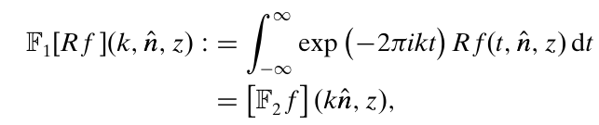
Fourier-slice theorem
The Fourier-slice theorem or the central slice theorem relates the 1D Fourier transform of a projection with the 2D Fourier transform of the region of the image from which the projection was obtained.
By the central slice theorem, the Fourier transform of Rf in direction n^ is equivalent to the slice of the Fourier transform of f along n^, i.e.

Slide 8

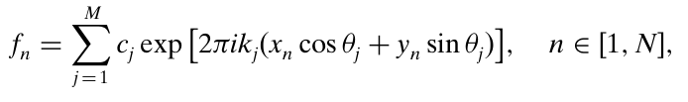
Nufft approach
On a discrete uniform grid, if a sufficient number of projections are available, inversion of the Radon transform entails computing Fourier coefficients along radial lines using a one-dimensional fast Fourier transform (FFT), followed by two-dimensional backward Fourier transforms from a non-uniform polar grid onto a Cartesian grid {(xn, yn)}, which can be represented as the summation where cj is the Fourier coefficient at kj, N is the number of discrete points that represent the sample density f on a uniform Cartesian grid, and M is the number of polar grid points representing the projection data.
Direct computation of this equation is computationally expensive.

Slide 9
Use of Non-Uniform Fast Fourier Transforms (NUFFT) as an efficient method for computing the inverse Radon transform in tomographic imaging
NUFFTs provide a precise and efficient alternative for computing the inverse Radon transform. The method involves:
Computing Fourier coefficients on a polar grid using a sequence of one-dimensional FFTs along radial lines.
Convolving the computed coefficients with a compactly supported spreading kernel. Evaluating this convolution on a uniform grid.
Performing an inverse Fourier transformation on the convolution values. Division by the Fourier transform of the kernel.

Slide 10
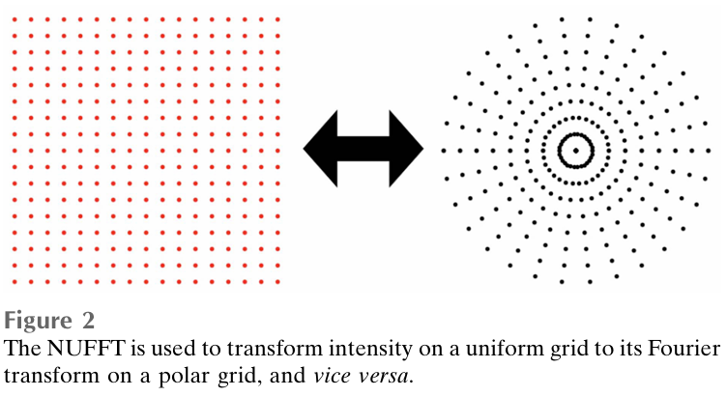
Role of kernel in the nufft process
The use of a kernel in the NUFFT process serves a crucial role in accurately handling non-uniformly sampled data and mitigating the challenges associated with direct computation of the inverse Radon transform
The kernel is introduced to address the non-uniformity of the sampled data. It acts as a weighting function that adjusts the contribution of each data point based on its position.
Think of the kernel as a smoothing function that spreads the influence of each data point to its neighboring points. This is especially important when the data points are irregularly distributed.
The compact support ensures that the influence of each data point is limited to a local region. This helps in controlling the computational complexity and improving efficiency
A wider kernel allows for a more accurate representation but may increase computational cost.

Slide 11
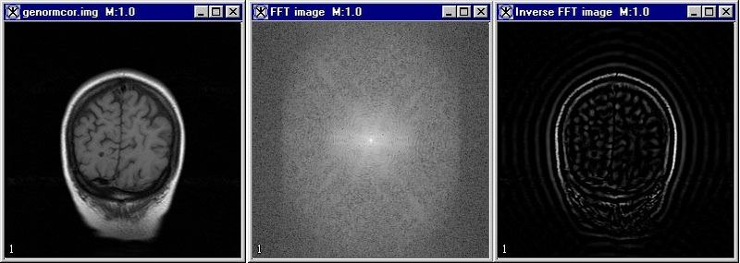
How fft speeds up mbir ?
The FFT operation is highly parallelizable, making it well-suited for modern computing architectures, including GPUs. This parallelization capability allows multiple FFT computations to be performed simultaneously, further enhancing computational efficiency
The reformulation of MBIR operators in terms of Fourier coefficients and the use of FFT result in a reduction in the overall computational complexity, making it more feasible to perform iterative reconstructions on large and complex datasets.

Slide 12

Problem Statement Detection of brain injuries using Fourier transform of sinograms
EE21B040 Poornachandra Giridhar
Ee21b056 k Pranav Reddy

Slide 13
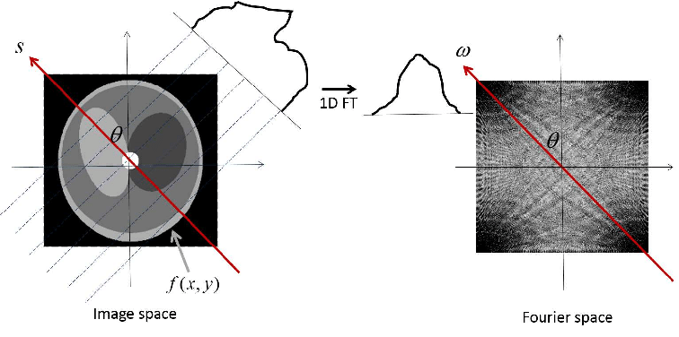
Dataset provided and Our Approach
The data set we got were sinograms of thousands of healthy and unhealthy patients.
Each sample was of the shape 360*362*3, where 360 denoted the angle, 362 was the length of the projection array and 3 was the channel that gave the information regarding the intensity of the radio waves absorbed by different parts of the brain.
Since we already had the sinogram which is nothing but the radon transform of the scan of the brain, we just implemented the Fourier slice theorem to get the 2D Fourier transform of the image.

Slide 14
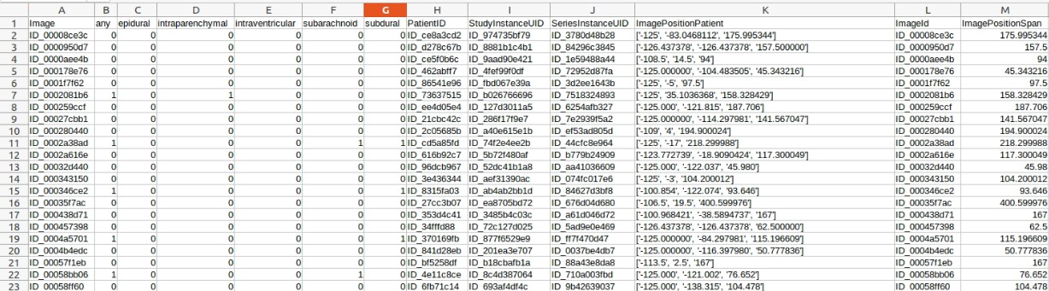
Glimpse of the text file

Slide 15
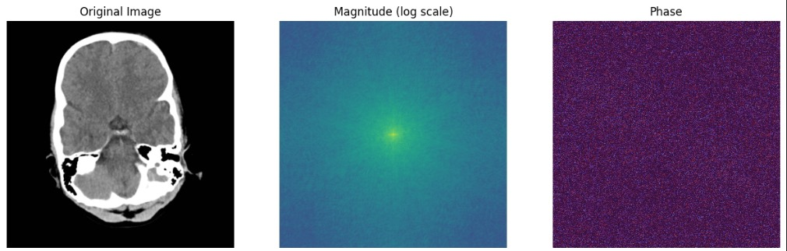
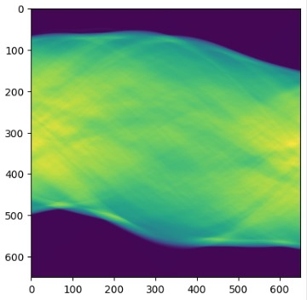
Some images from the implementation
Figure 1: The original scan of the brain and its Fourier Transform’s Magnitude and Phase.
Figure 2: The sinogram of the Brain scan.

Slide 16
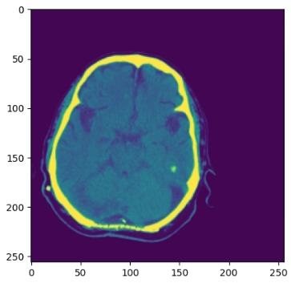
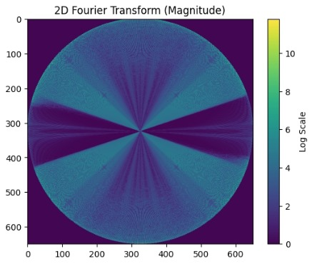
Figure 1: The Fourier Transform we get from using the Fourier Slice Theorem.
Figure 2: Another Brain scan.

Slide 17
Architectures we implemented
We made a data loader that takes the sinograms from a folder according to the Training text file, validation text and a testing text file which had both the sinogram npy file name and the ground truth i.e. whether the brain is injured or not.
After finding the Fourier transform at every angle, we only stored the magnitude of it in the training array.
We implemented three different types of architectures. Two of these are based on Convolution Neural Networks, and the other is based on Efficient Net.
The architectures based on CNN gave better results than the Efficient Net.
We also trained the model with different learning rate values and training dataset sizes, to get better outcomes.

Slide 18
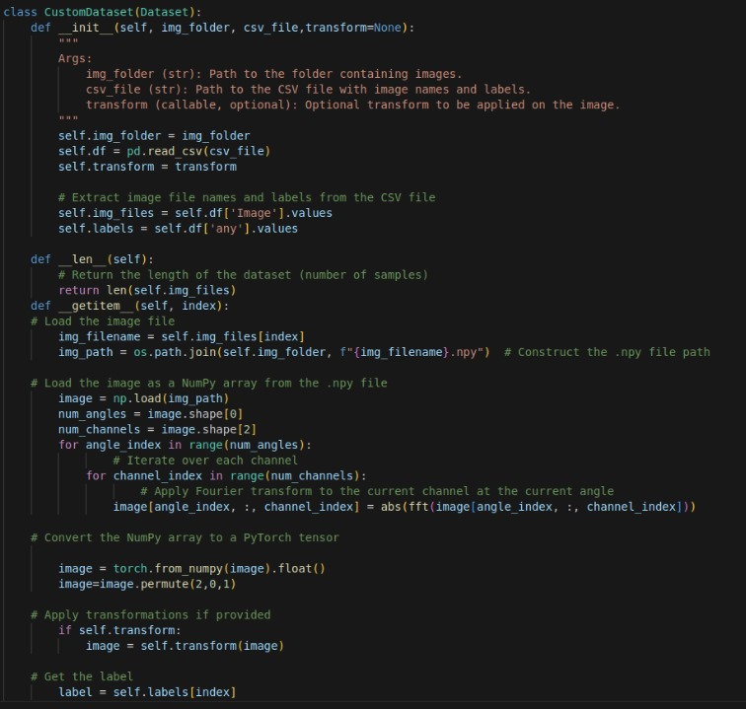
Since our Ground Truth and and npy files were there in different folders, We had to come up with our own Custom Dataset.
Also since only sinograms were available, we had to use the Fourier slice theorem and then take the magnitude of the Fourier arrays

Slide 19
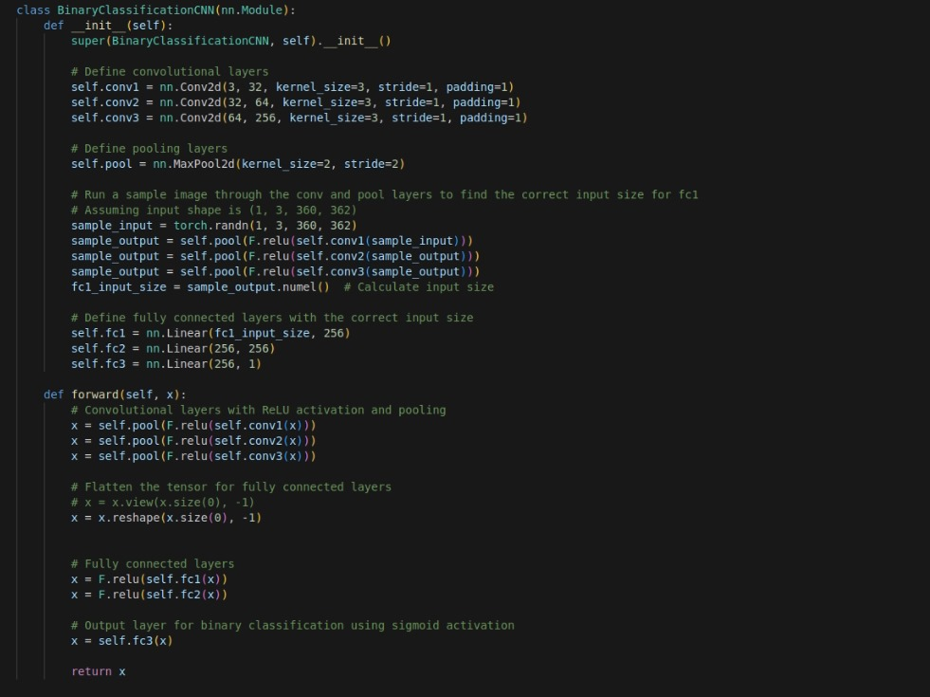
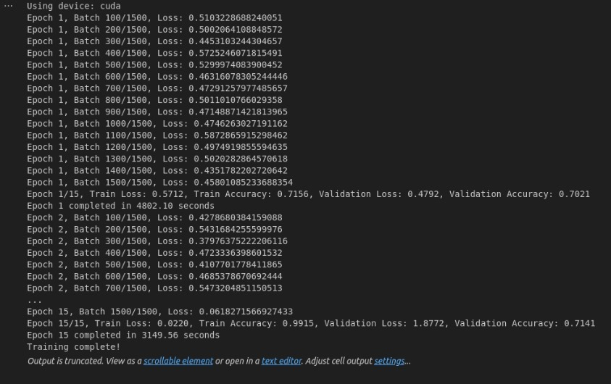

Architecture – 1 (CNN Based)

Slide 20
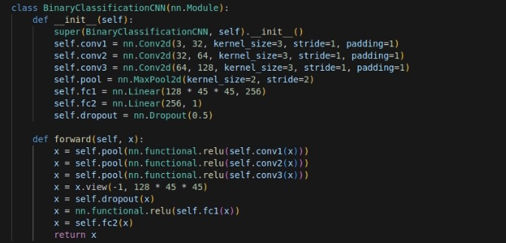
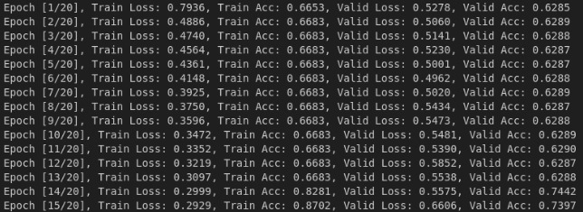

Architecture – 2 (CNN Based)

Slide 21
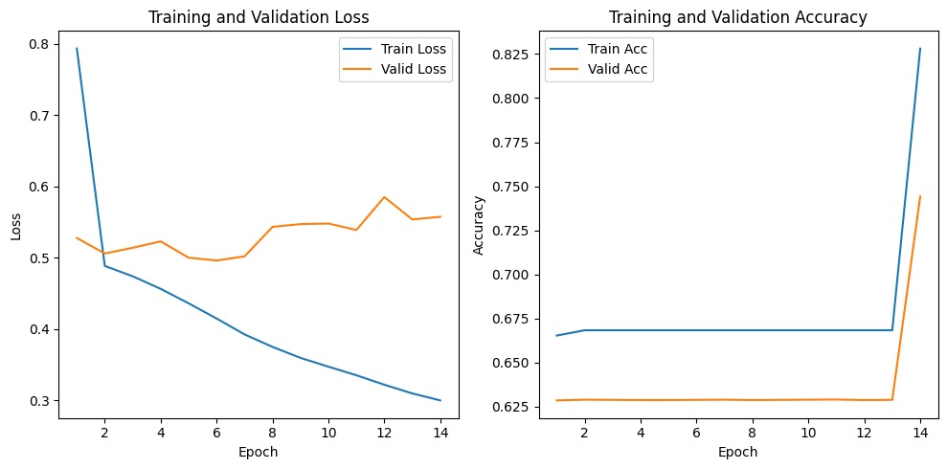
Plots and observations

Slide 22
Future research prospects
We have so far focused solely on the magnitude of the Fourier coefficients. Exploring the phase of the coefficients, or even combining both magnitude and phase for prediction, presents intriguing possibilities.
In our preliminary work, we employed a simple convolutional neural network (CNN). However, considering the interdependence of slices, exploring the use of Recurrent Neural Networks (RNNs) could yield valuable insights.
Combining results from Fourier analysis with conventional approaches warrants investigation to ascertain whether enhanced performance and outcomes can be achieved.
Increasing the complexity of the model will also help in resolving the overfitting problem.

Slide 23
Conclusion
The results achieved, while not groundbreaking, are nonetheless promising and encouraging. They indicate that Fourier analysis of sinograms holds the potential for detecting brain injuries, offering the prospect of significantly reducing CT scan reconstruction time and expediting patient diagnosis, ultimately saving lives.
In conclusion, this area holds significant promise for further research and stands to offer substantial benefits to the field of medical imaging.

Slide 24
THANKYOU

